Slide 1

Distributed Systems

Slide 2
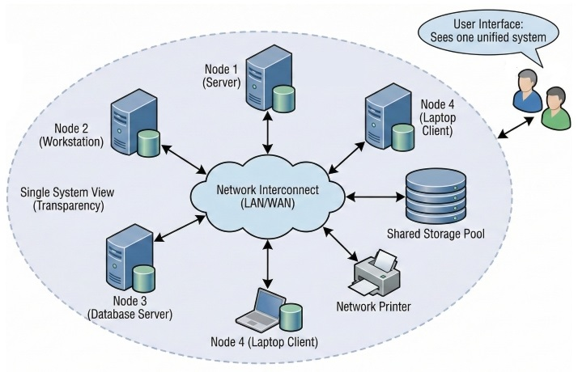

What is a Distributed System?
A distributed system is a collection of independent computers (called nodes) that communicate over a network and coordinate actions via message passing.
To the end-user, the entire network appears as a single coherent computer system, hiding all underlying complexities.
Core Properties: Concurrent execution, independent component failures, and lack of a shared global clock.

Slide 3
Advantages & Disadvantages
Evaluating trade-offs in distributed infrastructure

Slide 4




Advantages of Distributed Systems
Scalability
Fault Tolerance
Systems scale horizontally by adding more compute nodes to handle increasing workloads smoothly.
If a single node fails, backup replicas take over seamlessly, ensuring continuous service.
Resource Sharing
Performance
Costly hardware components and datasets can be shared efficiently across various locations.
Heavy computation tasks can be broken down and processed concurrently across multiple nodes.

Slide 5
Disadvantages & Challenges
System Complexity
Network Latency
Designing, debugging, and maintaining distributed apps is vastly harder than monolithic systems.
System speed is heavily bound by transmission delays, packet losses, and bandwidth limits.
Data Consistency
Security Risks
Synchronizing data consistently across independent nodes introduces complex consensus hurdles.
Expanded network surfaces increase vulnerabilities, requiring robust encryption and controls.

Slide 6
Transparency Concepts
Hiding network distribution complexity from users

Slide 7
Transparency Types (1/2)
Access Transparency: Hides differences in data representation and resource access protocols. Users interact with local and remote resources uniformly.
Location Transparency: Hides the physical location of resources. Users access services without knowing where they reside physically.
Migration & Relocation: Allows resources or active processes to move between nodes dynamically without interrupting user sessions.

Slide 8
Transparency Types (2/2)
Replication Transparency: Presents multiple data copies across different locations as a single logical resource to improve reliability.
Concurrency Transparency: Enables multiple independent users to access and modify shared resources simultaneously without conflicts.
Failure & Performance: Automatically masks hardware/network faults and adjusts system capacity dynamically under traffic spikes.

Slide 9
Transparency Reference Matrix
Transparency Type | Primary Goal | Practical Example
Access | Uniform resource access methods | Opening local and remote files with identical commands
Location | Hide physical node addresses | Accessing web services via URL without knowing server IP
Replication | Manage multiple data copies seamlessly | Distributed databases synchronizing records behind scenes
Failure | Mask component crashes internally | Secondary backup server taking over automatically upon crash

Slide 10
Summary & Review
Mastering distributed architectures requires balancing scalability against operational complexity.

